Slide 1
Memory Organization
Memory Hierarchy
Main Memory
Associative Memory
Cache Memory
Virtual Memory
Memory Management Hardware

Slide 2
Memory Hierarchy
Memory hierarchy system consists of all storage devices employed in a computer system
from the slow but high-capacity auxiliary memory to a relatively faster main memory, to an even smaller and faster cache memory
Goal of Memory Hierarchy
To obtain the highest-possible average access speed while minimizing the total cost of the entire system

Slide 3
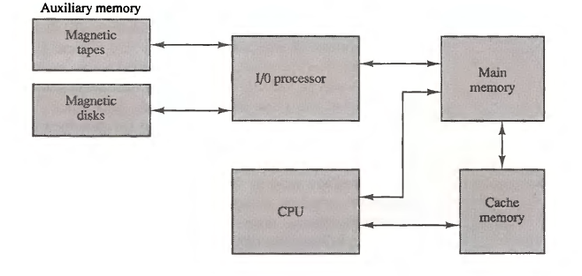
Memory hierarchy in a computer system

Slide 4
Main memory
Relatively large and fast memory used to store programs and data during computer operation
Available in two possible modes:
Static
Use flip-flops to store binary information
Generally used for implementing cache memory
Dynamic
Capacitors are used to store binary information in the form of electric charges
Generally used for implementing main memory

Slide 5
Contd..
Main memory: RAM and ROM
RAM
To distinguish from ROM it is aka read write memory because ROM is also random access memory
Used for storing the bulk of the programs and data that are subject to change
ROM
Used for storing programs that are permanently resident in the computer
Needed for storing an initial program called a bootstrap loader
Bootstrap loader is a program whose function is to start the computer software operating when power is turned on

Slide 6
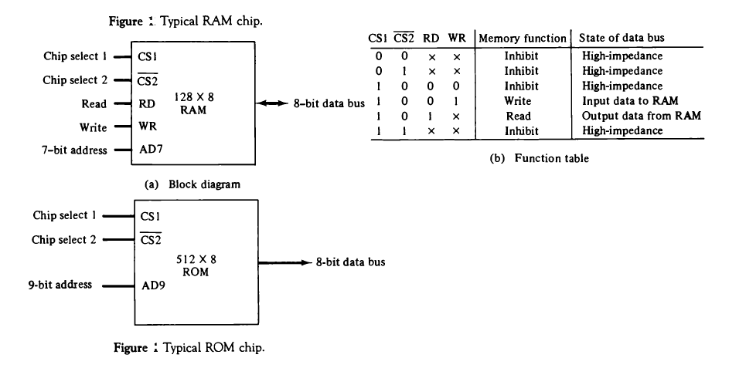
RAM and ROM chips

Slide 7
Questions
Design a computer system such that it should contain 512 byte of RAM and 512 bytes of ROM using four 128 byte RAMs and one 512 byte ROM (assume address line of 12 bit)
Design a computer system such that it should contain 16Kbyte of ROM and 4 Kbyte of RAM using two 8 Kbyte ROMs and two 2 Kbyte RAMS (assume address line of 16 bit)

Slide 8
Associative Memory
A memory unit accessed by content is called an associative memory or content addressable memory (CAM)
Associative memory can be accessed simultaneously and in parallel on the basis of data content rather than by specific address or location
Hence the time required to find an item stored in memory is very fast
Associative memory is expensive than RAM because each cell must have storage capability as well as logic circuits for matching its content with an external argument
Application: used where search time is very critical and must be very short

Slide 9
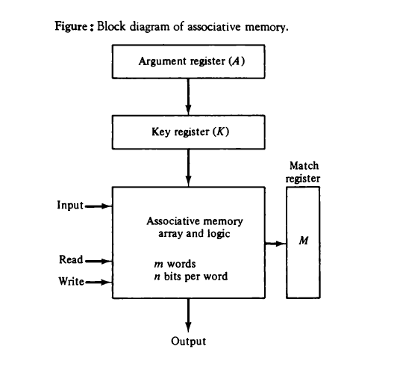
Contd..
Each word in memory is compared in parallel with the content of the argument register.
Key register provides mask for choosing a particular field or key in the argument word
After matching process, those bits in the match register that have been set indicate the fact that their corresponding words have been matched

Slide 10
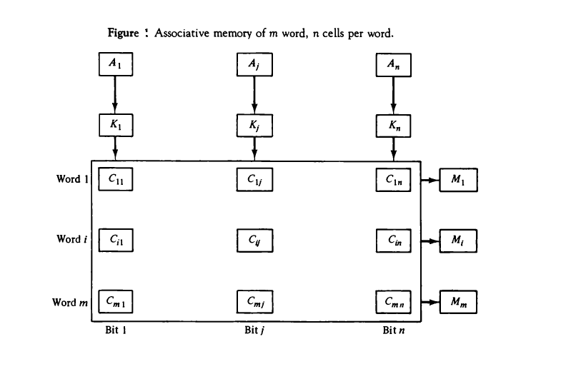
Contd..

Slide 11
Contd..
Read operation
If more than one word in memory matches the unmasked argument field, all the matched words will have 1’s in the corresponding bit position of the match register.
All the matched words are read in sequence by applying a read signal to each word line whose corresponding bit in matched register is set.
Write operation
If the entire memory is loaded with new information at once prior to a search operation then the writing can be done by addressing each location in sequence
If unwanted words have to be deleted and new-words inserted one at a time, there is a need for a special register called tag registers to distinguish between active and inactive words. Corresponding bit in tag registers is 1 for active and 0 for inactive words. Words are stored in memory by scanning the tag register until the first 0 bit is encountered where a new word is stored and after storing, this tag bit is set to 1.

Slide 12
Cache Memory
The property of Locality of Reference makes the Cache memory systems work.
Cache is a fast small capacity memory that should hold those information which are most likely to be accessed
Basic operation of the cache:
When the CPU needs to access memory, the cache is examined first. If the word is found in the cache, it is read from the fast memory else the main memory is accessed to read the word. A block of words containing the one just accessed is then transferred from main memory to cache memory. The block size may vary from one word (the one just accessed) to about 16 words adjacent to the one just accessed. In this manner, some data are transferred to cache so that future references to memory find the required words in the fast cache memory.

Slide 13
Contd..
The performance of cache memory is measured in terms of a hit ratio quantity called hit ratio.
When the CPU refers to memory and finds the word in cache, it is said to produce a hit. If the word is not found in cache, it is in main memory and it counts as a miss.
The ratio of the number of hits divided by the total CPU references to memory (hits plus misses) is the hit ratio.
Main purpose of using cache memory is to improve the average memory access time. (So that the average access time is closer to the access time of the fast cache memory.)

Slide 14
Numerical
Given that the cache access time as 10 ns, memory access time as 100 ns and cache hit rate as 90%, calculate the effective memory access time
Consider a computer with cache access time of 100ns, a main memory access time of 1000ns and a hit ratio of 0.9 . Find an average memory access time.

Slide 15
Cache mapping
The transformation of data from main memory to cache memory is referred to as a cache mapping process
There are three types of cache mapping
Associative mapping
Direct mapping
Set-associative mapping

Slide 16
Associative mapping
Fastest and most flexible
Associative memory stores both the address and content of the memory word

Slide 17
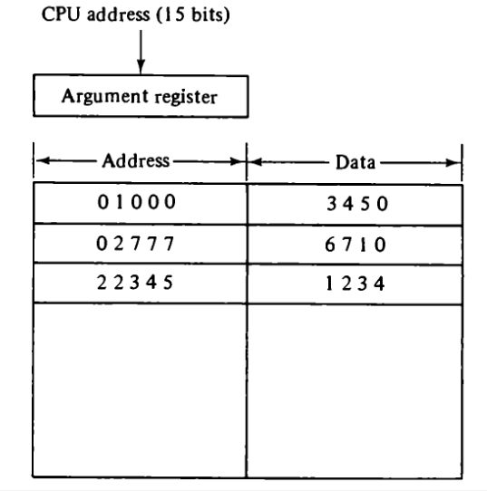
Contd..

Slide 18
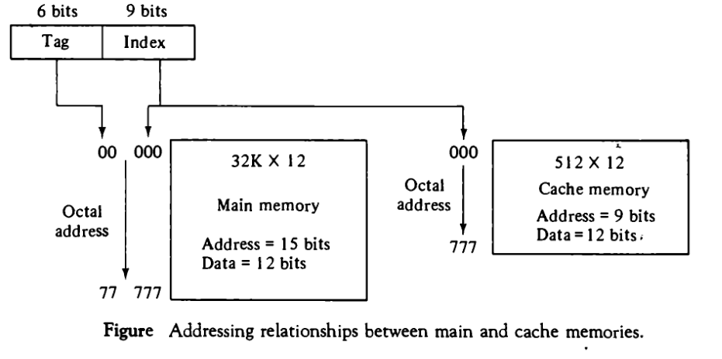
Direct mapping

Slide 19
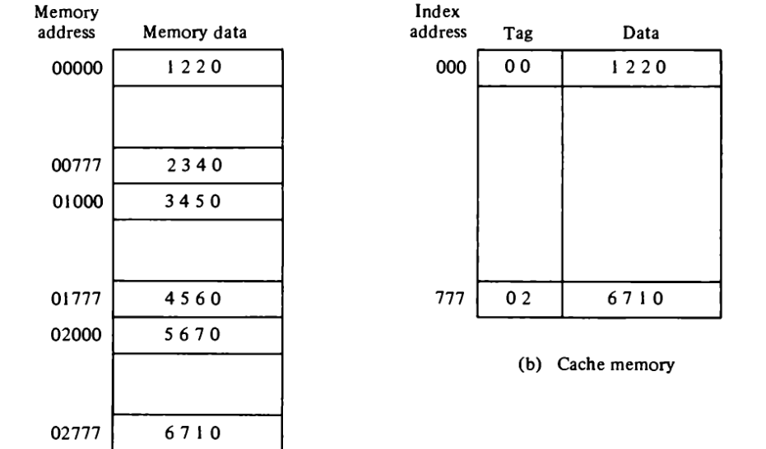
Contd..

Slide 20
Contd..
Disadvantage
Hit ratio drop considerably if two or more words whose addresses have the same index but different tags are accessed repeatedly

Slide 21
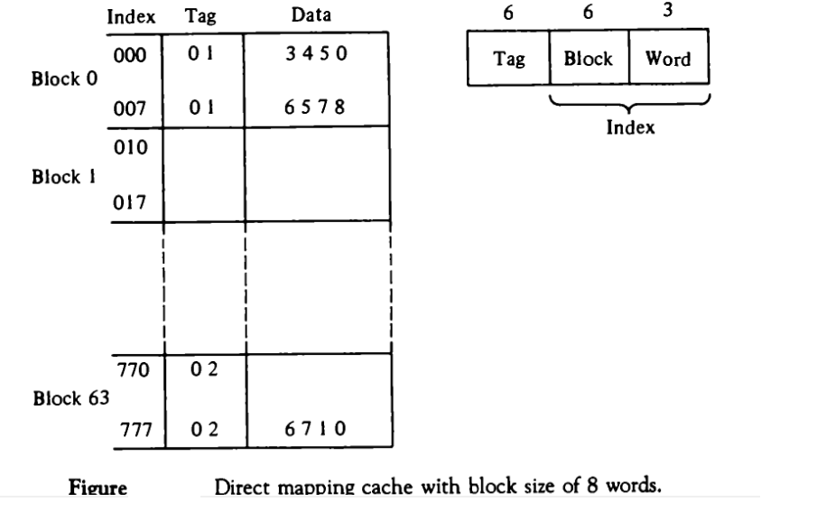
Contd..

Slide 22
Set associative mapping
Improvement over the direct mapping organization
Can store two or more words of memory under the same index address
Each data word is stored together with its tag and then number of tag-data items in one word of cache is said to form a set

Slide 23
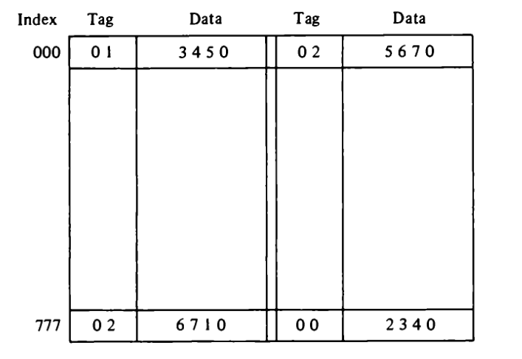
Set associative mapping

Slide 24
Assignment
A personal computer has main memory of 32k x 8 bytes and cache memory of 512 words. The cache is directly mapped with block size of 4 words.
How many bits are required in tag, index block and word fields of the address format?
A two-way set associative cache memory uses blocks of four words. The cache can accommodate a total of 2048 words from the main memory. The main memory size is 128 ×32 K.
How many bits are there in the tag, index block and word fields of the address format?
What is the size of the cache memory?

Slide 25
Writing in to cache
Two approach
Write through method
Write back method

Slide 26
Virtual Memory
A concept used in some large computer systems that permits the user to construct programs as though a large memory space were available, equal to the totality of auxiliary memory
Due to virtual memory we can run large program with in limited physical memory
Virtual memory gives programmer the illusion that they have large memory and provides mechanism for dynamically translating program-generated addresses into correct main memory locations.
The translation or mapping is handled automatically by the hardware by means of a mapping table

Slide 27
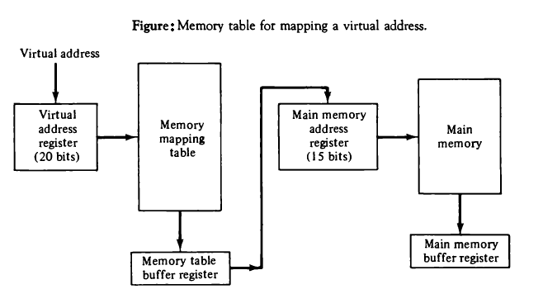
Contd..

Slide 28
Contd..
Different terminology used in virtual memory
Virtual address: address used by a programmer
Address space: Set of virtual addresses
Location or Physical address: address in main memory
Memory space: set of physical address
Pages: groups of address space of the same size. Logical concept
Frames (Blocks): groups of physical address of equal size.

Slide 29
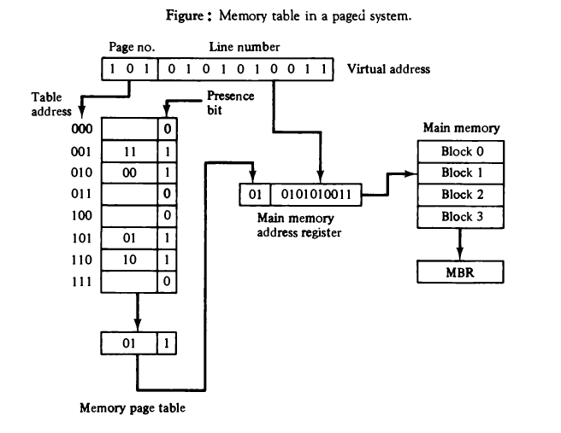
Address mapping using pages

Slide 30
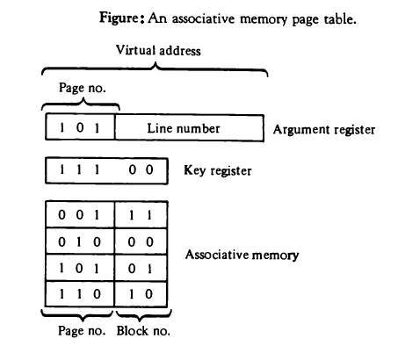
Associative Memory page table

Slide 31
Page Replacement
Two most common page replacement algorithms
First in first out (FIFO)
Least recently used (LRU)
A virtual memory system has an address space of 8K words, a memory space of 4K words, and page and block sizes of 1K words. The following page reference changes occur during a given time interval.
4 2 0 1 2 6 1 4 0 1 0 2 3 5 7
Determine the four pages that are resident in main memory after each page reference change if the replacement algorithm used is a) FIFO b) LRU

Slide 32
Contd..
A virtual memory system has 6k words of address space and 3k words of memory space. Page references are made by CPU in following sequence:
3, 2, 0, 3, 4, 1, 2, 2, 0
Find out the pages that are available at the end if the replacement algorithm used is (a) LRU (b) FIFO Assume the page and block size of 1k words.

Slide 33
Memory Management Hardware
In multiprogramming environment, memory management system provides a procedures form managing the various programs residing in memory
Memory management system is a collection of hardware and software (memory management software is part of an overall operating system)
Basic components of memory management unit are:
Facility for dynamic storage relocation
Provision for sharing common programs
Protection of information against unauthorized access

Slide 34
Contd..
The dynamic storage relocation hardware is a mapping process similar to paging system
Segment:
process of dividing programs and data into logical parts despite of fixed-size pages
Set f logically related instructions or data elements
Generated by programs or OS.
Eg. Array of data, a table of symbols or users program
Logical address
Address generated by the segmented program
Similar to virtual address but it is of variable-length

Slide 35
Segmented page mapping
The length of each segment is allowed to grow and contract according to the needs of the program being executed.
One way of specifying the length of a segment is by associating with it a number of equal-sized pages
Logical address is partitioned into:
Segment fields
Specifies segment number
Page fields
Specifies page within the segment
Word fields
Specifies specific word within the page

Slide 36
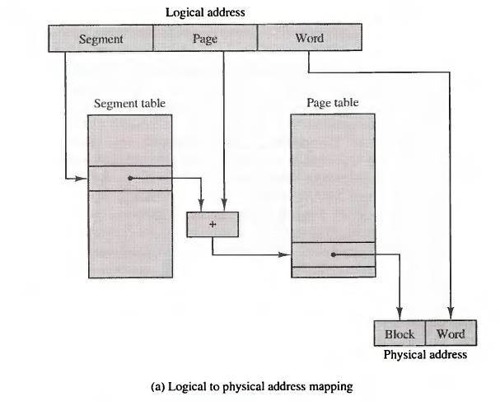
Contd..

Slide 37
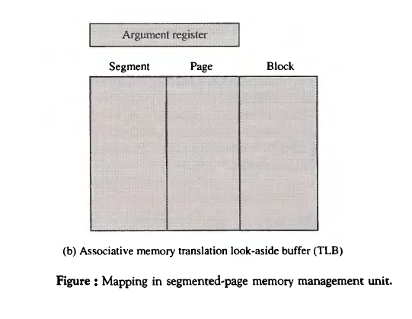
Contd..

Slide 38
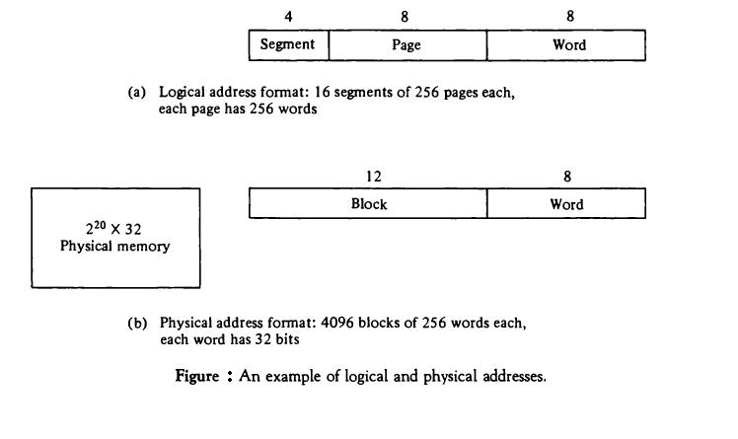
Numerical Example

Slide 39
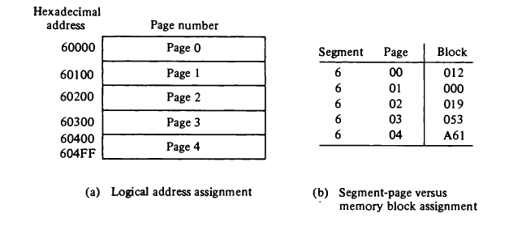
Contd..

Slide 40
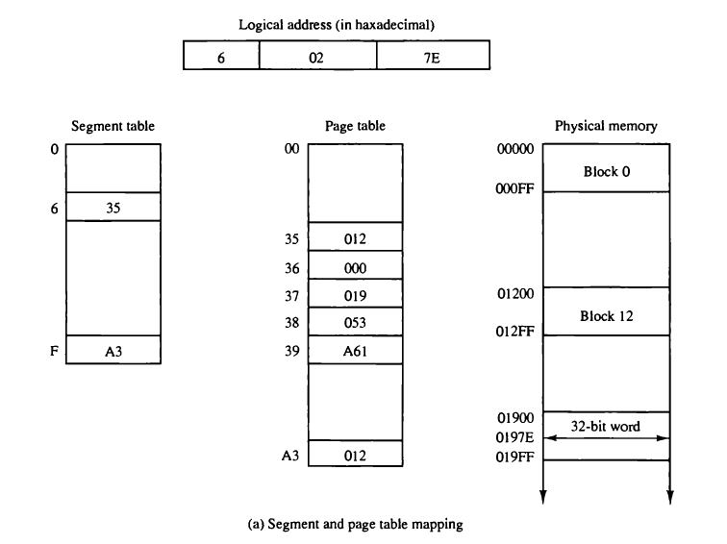
Contd..

Slide 41
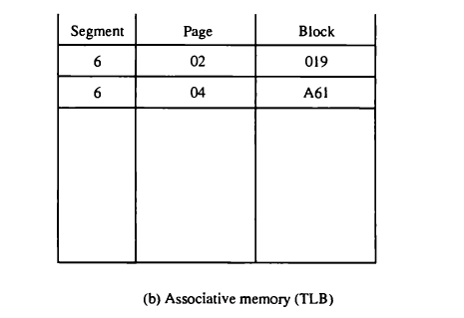
Contd..

